Slide 1





Team 3
Umut Demirhan
Mai Vy Nguyen
Dinh Nghi Dung Le
Duy Pham
(Leader)

Slide 2

COVID-19 Analysis
The primary objective of this project is to derive actionable insights from the publicly available COVID-19 data(OWID) that can inform health-related decision-making in Australia and support evidence-based interventions and policies.
Python language has been used for this analysis.

Slide 3
Agenda
Panoramic view of covid 19 (Global and Australia)
Effect of strict policies on reproduction rate
Correlation between countries
Country clustering analysis
Vaccination impact analysis
Conclusion & Recommendation

Slide 4
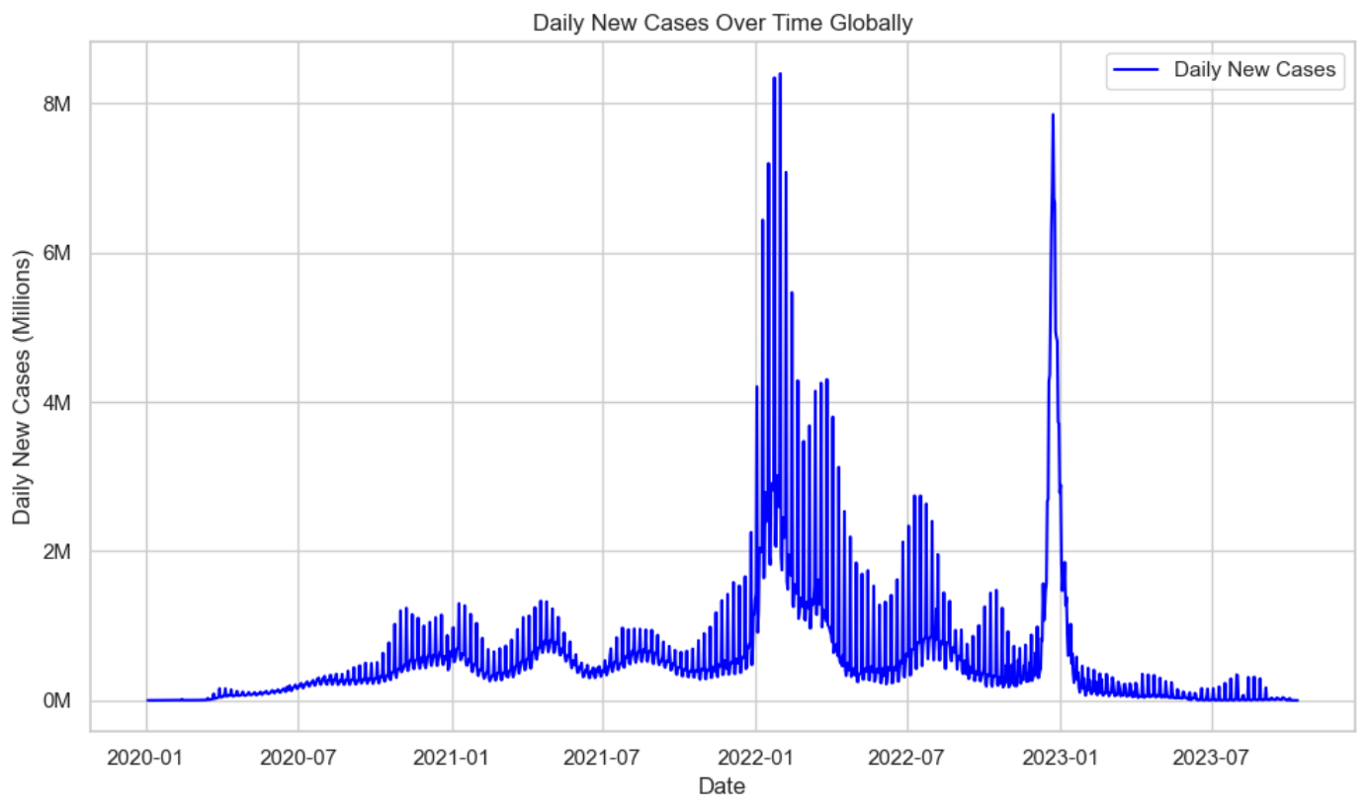

Slide 5
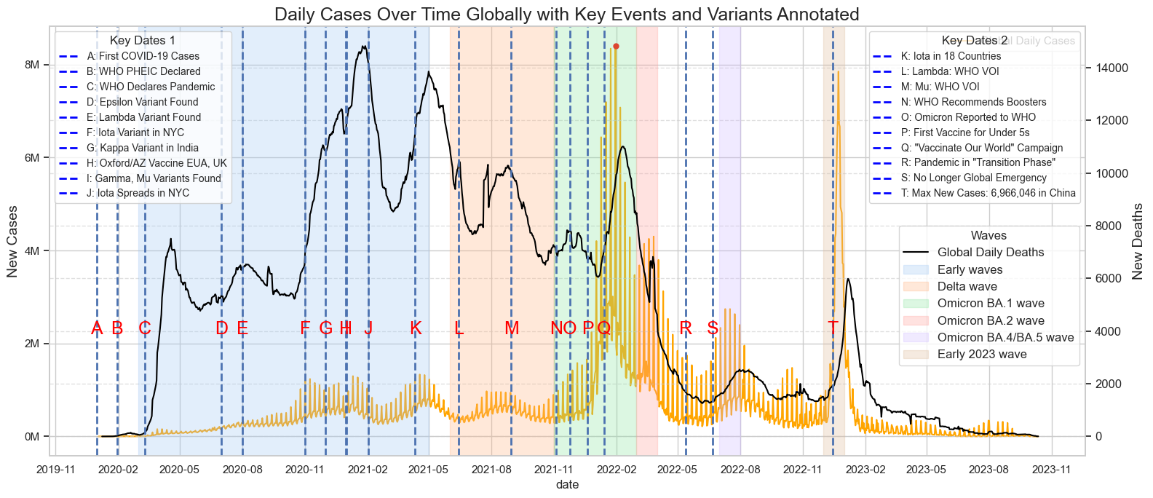
Panoramic view for Covid-19 in Global

Slide 6
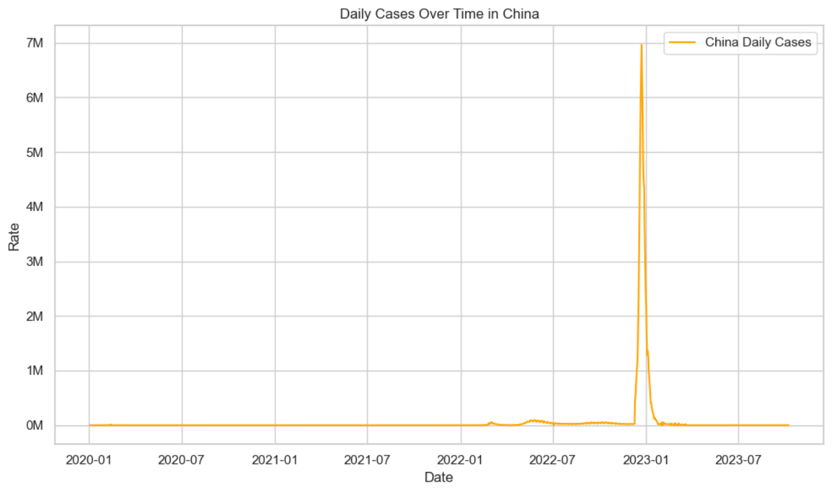

Slide 7
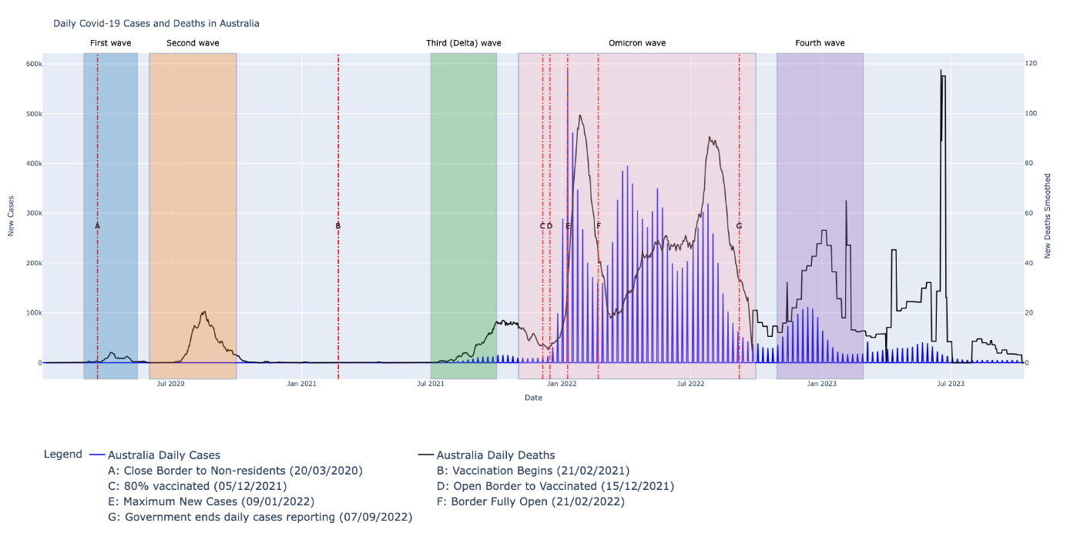
Panoramic view for Covid-19 in Australia

Slide 8
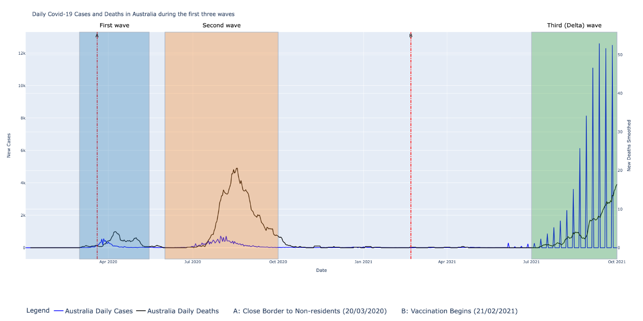

Slide 9
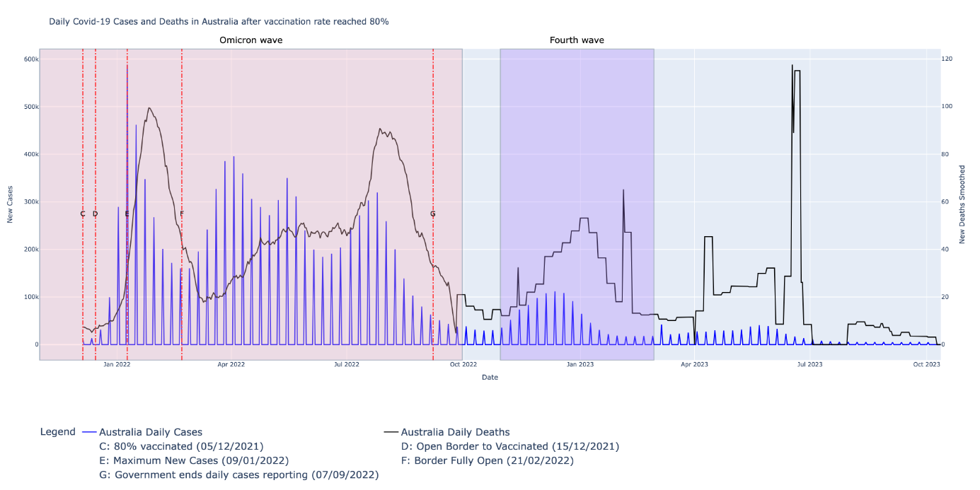

Slide 10

Hypothesis Test: Does the strictness of health measures influence the COVID-19 reproduction rate in Australia?
Objective: Analyze the relationship between health measure stringency and COVID-19 reproduction rate.

Slide 11
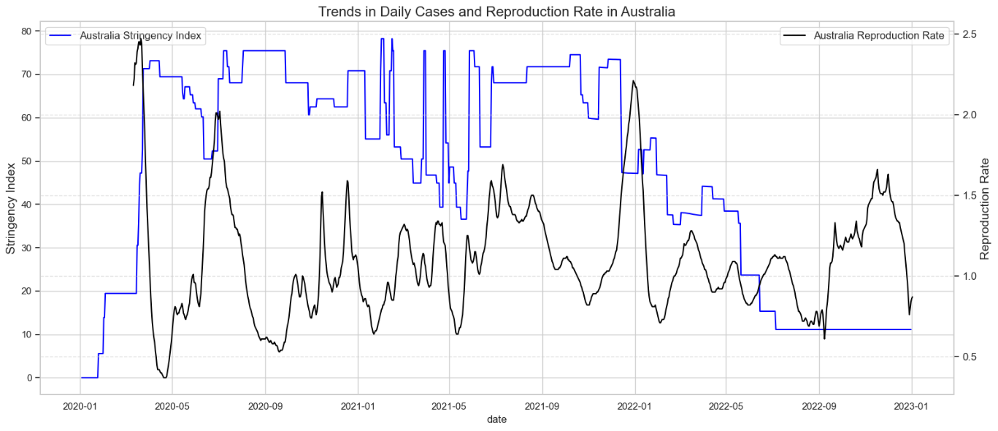
Blue line: Strictness of health measures over time. Zero being full freedom, and A hundred being full restriction.
Black line: COVID-19 reproduction rate. A rate above one means the epidemic is growing; below one, it's declining.
No clear trend indicates the impact of the strictness of the policies on the reproduction rate. It is simply due to the plot representing too generalized data.

Slide 12
OLS models with and without lags has been used, along with some data transformation in Python.
Only 2% of the variability in the reproduction rate of COVID-19 can be explained by the Stringency Index. This indicates a very weak explanatory power of the model.
For each unit increase in Stringency Index, the reproduction rate decreases by 0.002 on average.
Thus. the model confirms a statistically significant negative relationship with a P-value < 0.0001.
Further and deeper analysis may reveal the effect of strict policies better by focusing on more local areas and adding variables for each measure.

Slide 13
Correlation Analysis
It is critical to assess the relationship between new COVID-19 cases per million in other countries and those in Australia
It helps predict future case patterns in Australia based on worldwide statistics, ensuring that the country is better equipped to deal with the issues that the epidemic poses.

Slide 14
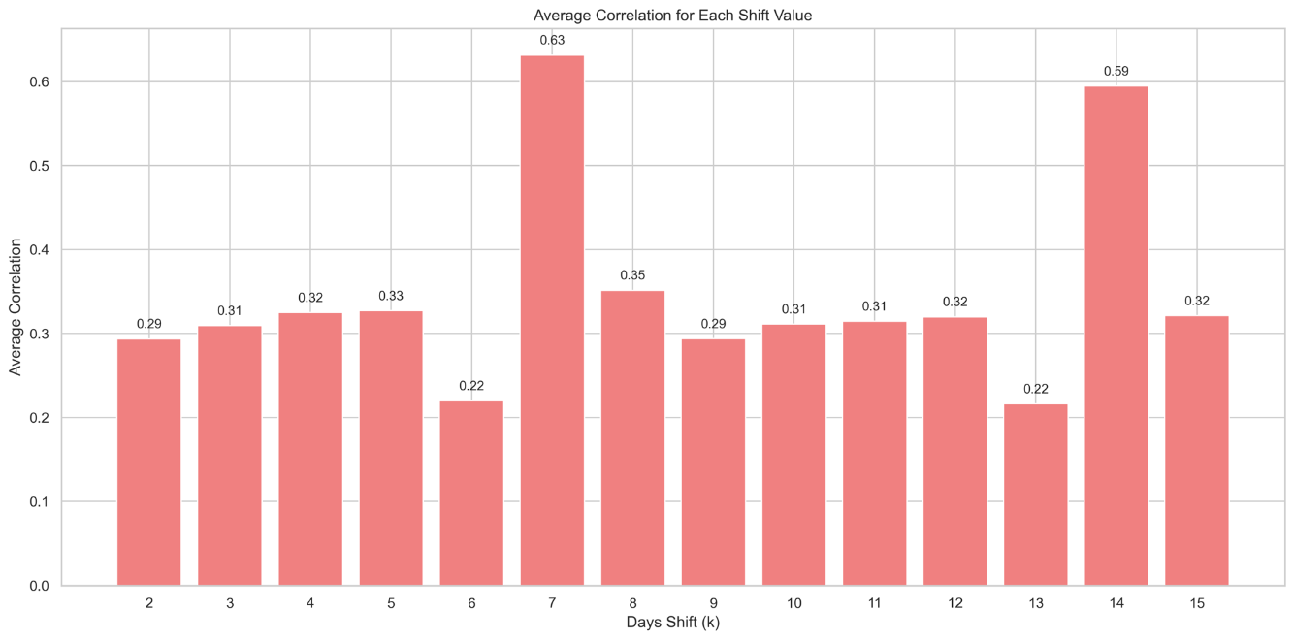
Shift of 7 Days Shows High Correlation
Shift of 7 Days Shows High Correlation: Interestingly, when shifting Australia's data by 7 days (a week), the correlations with major European countries become very high.

Slide 15
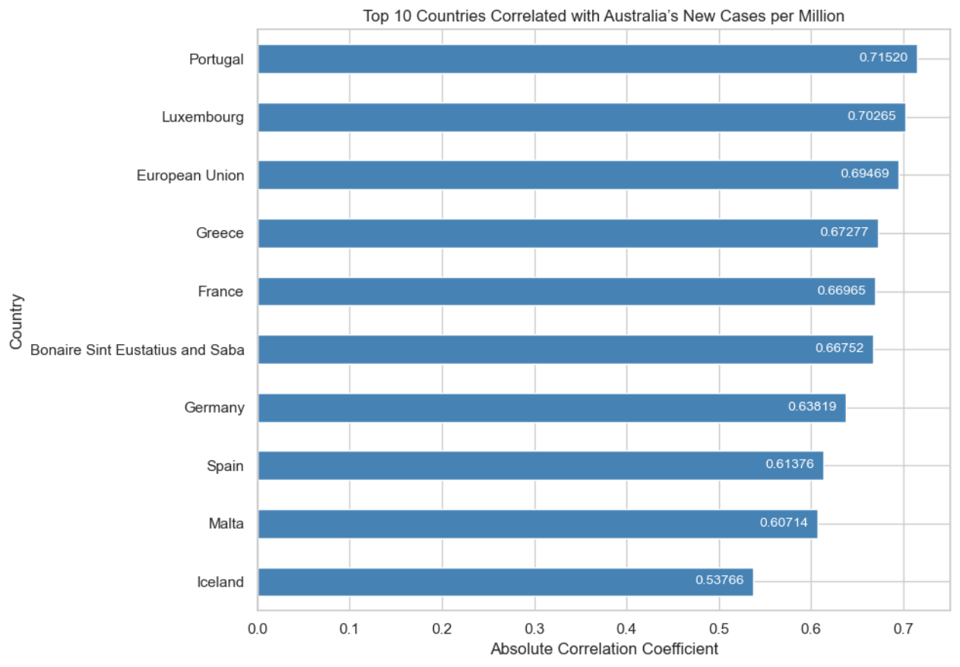

Slide 16
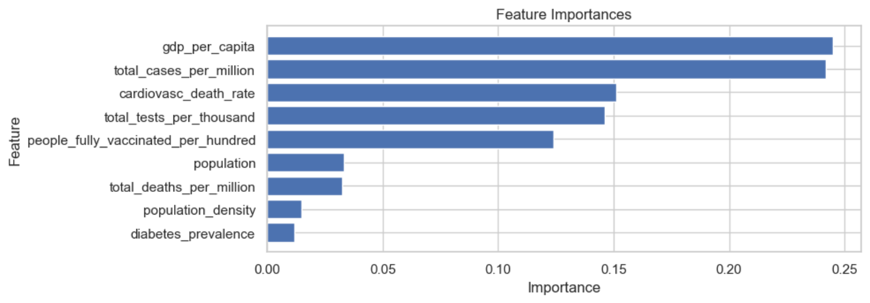
Clustering Analysis
By creating clusters, large datasets can be summarized with a limited number of representative categories or clusters, making the data easier to analyze and interpret.

Slide 17
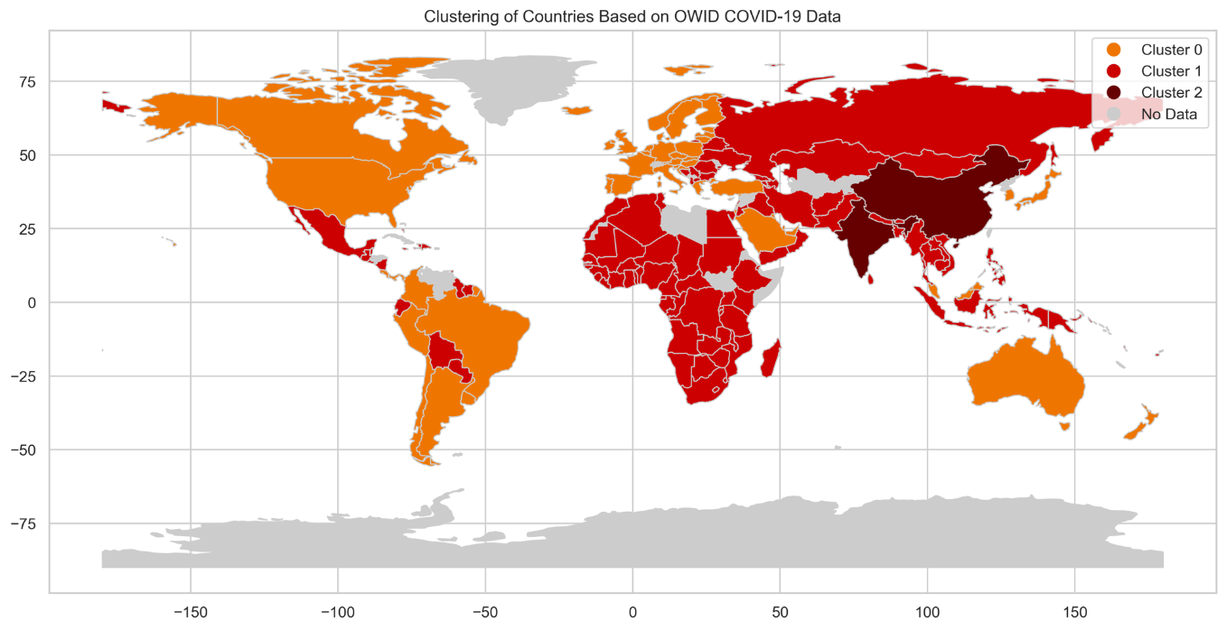

Slide 18
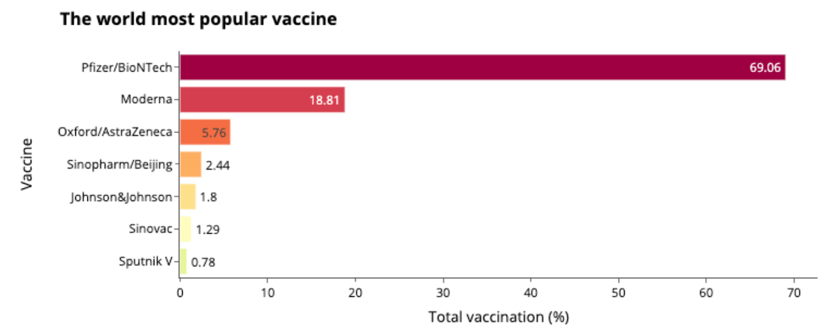
Vaccination distribution

Slide 19
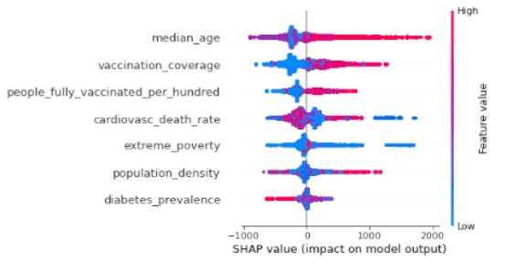
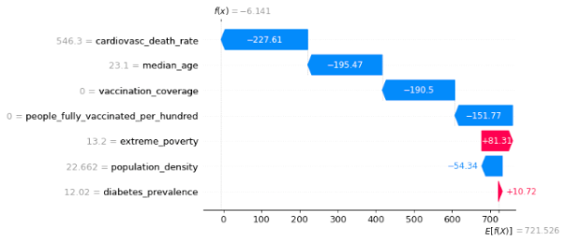
Vaccination reduces death rate
Key findings: widespread vaccination coverage, targeted healthcare interventions, and socio-economic factors are key players in lessening the impact of COVID-19.
Method: XGBoost, SHAP analysis
Result: Root Mean Squared Error (RMSE) = 258.86418
The two plots show the contribution of each feature to the XGB model prediction.

Slide 20
Conclusion & Recommendation
The stringency index is significantly associated with a decrease in the reproduction rate. However, further analysis required to see actual effect of measures.
After a one-week adjustment to Australia's data, there's a pronounced correlation with prominent European countries. Strictly observe the situation in European Union to react accordingly.
Three key players in lessening the impact of COVID-19: widespread vaccination coverage, targeted healthcare interventions, and socio-economic factors

